Slide 1
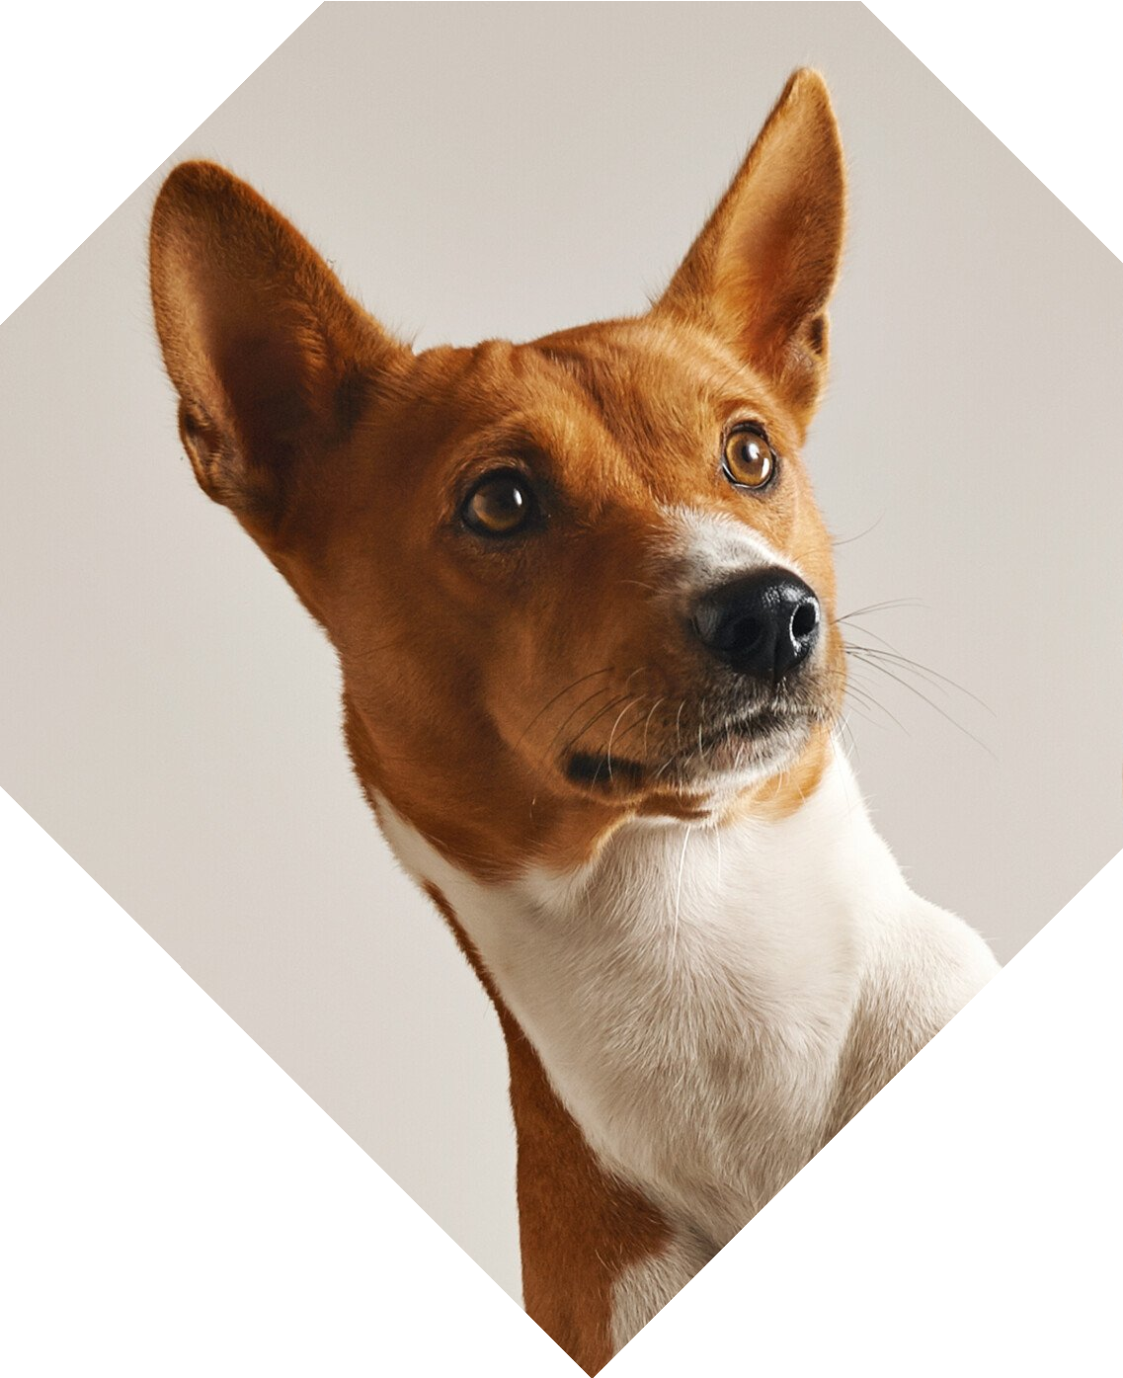
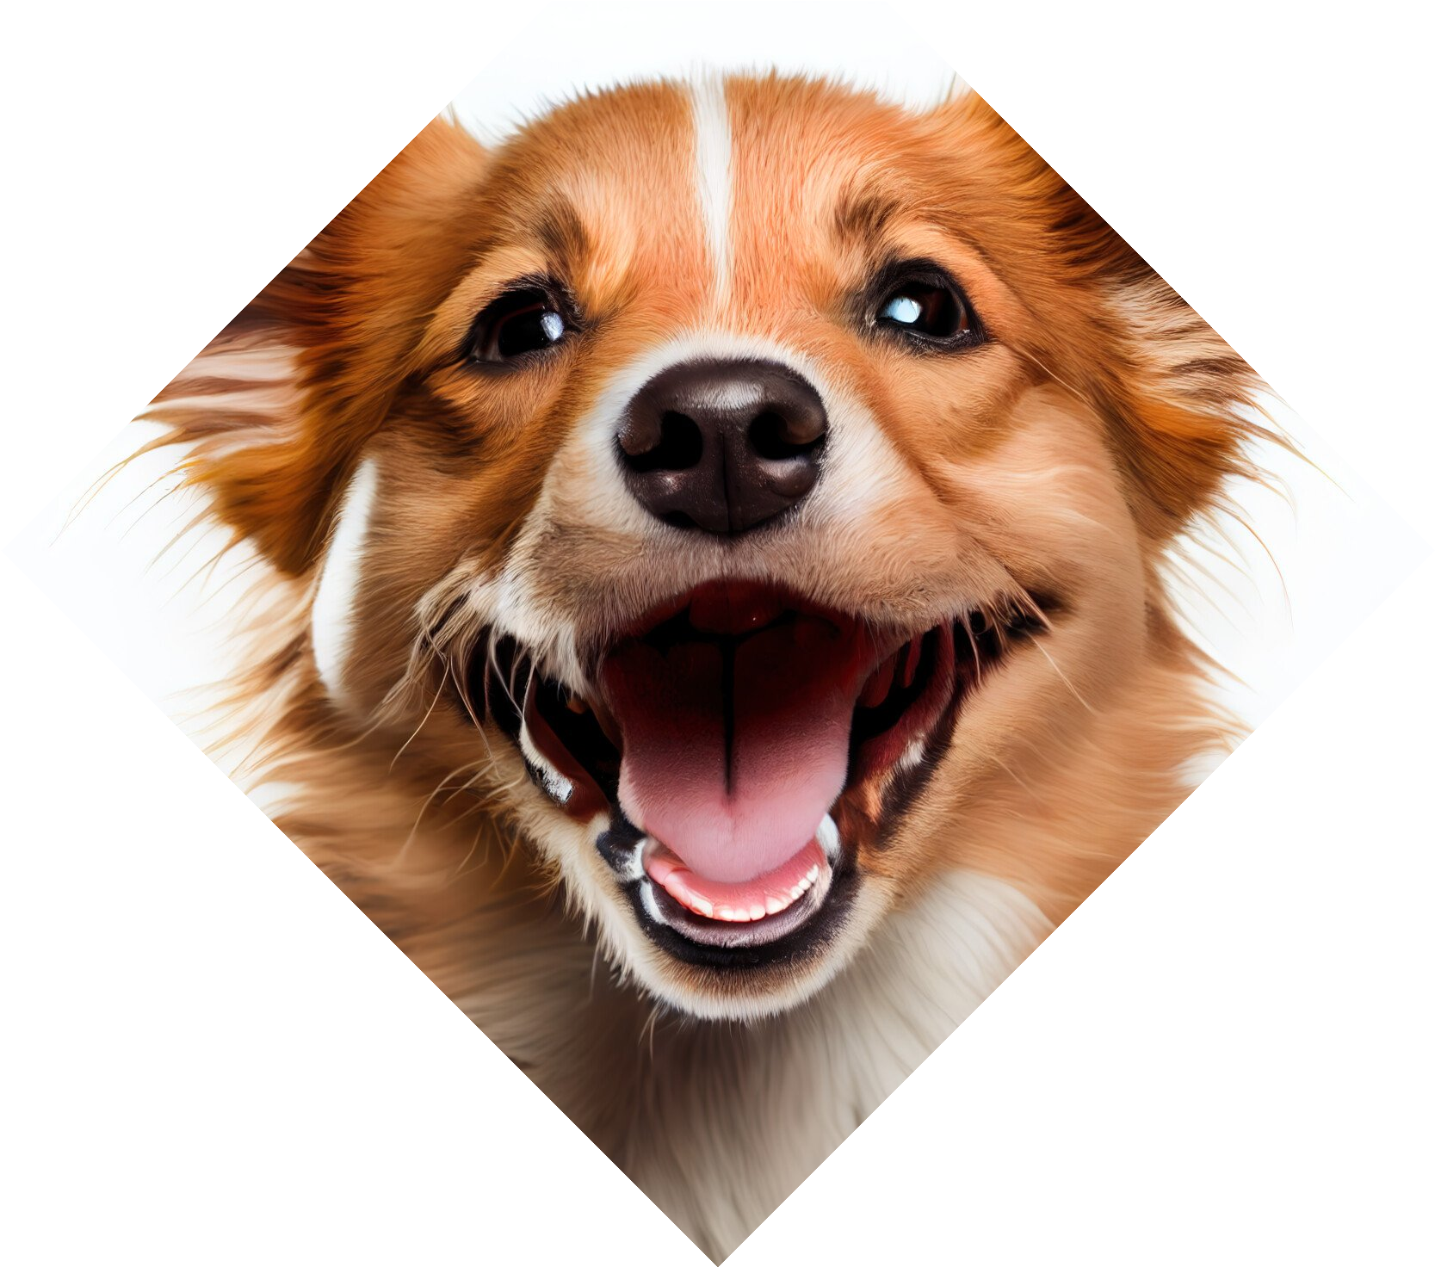
Accurate Identification of Dog Breeds through Resnet50's Power

Slide 2
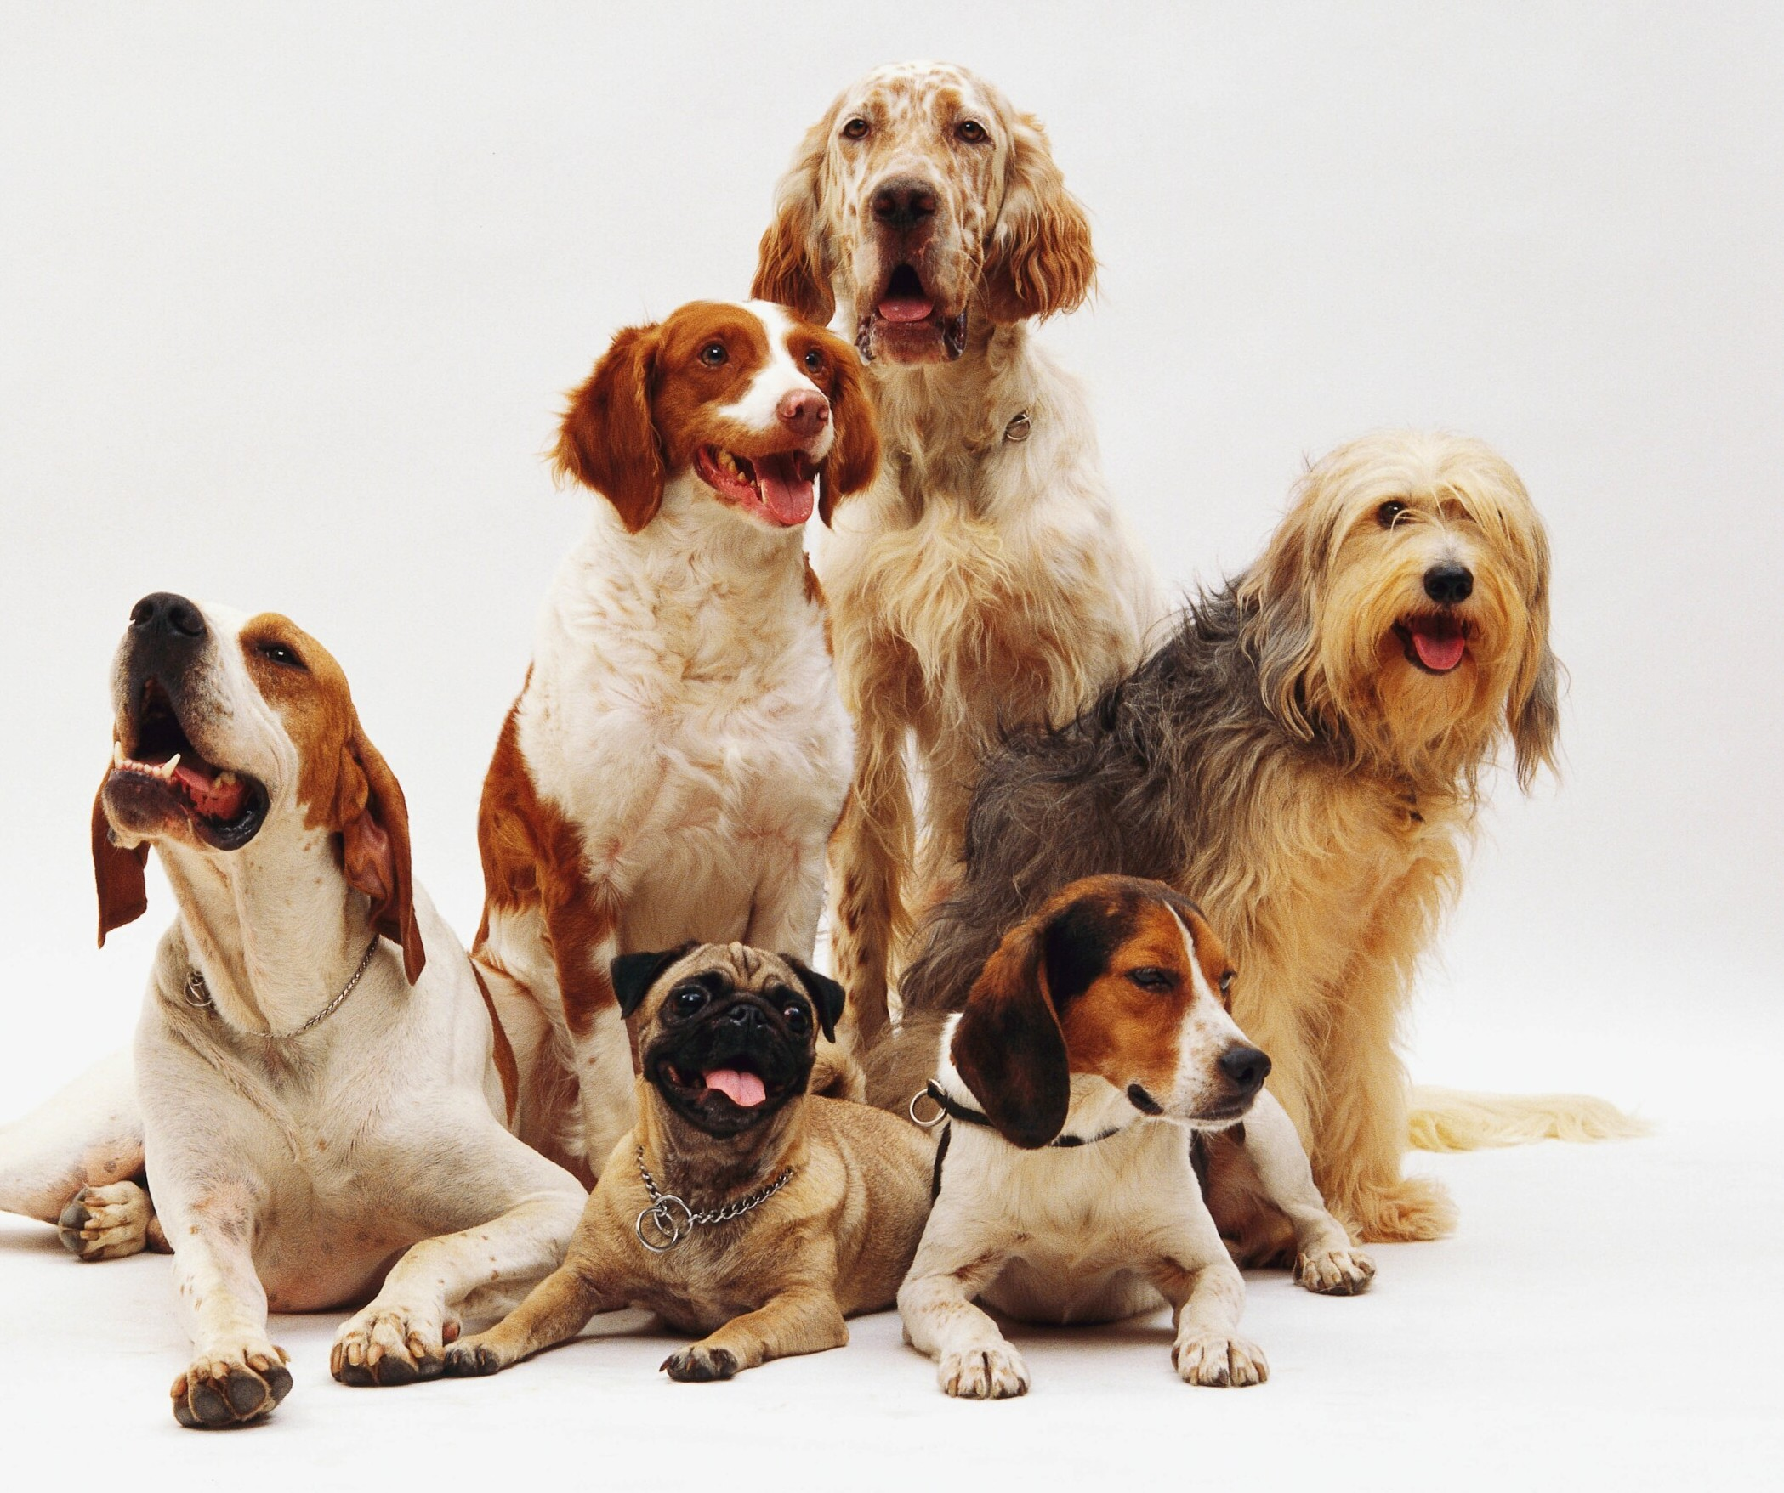
Introduction
The Dog Breed detection system is developed by harnessing deep learning techniques specifically implementing the use of a pretrained Resnet50 architecture.

Slide 3
What is Deep Learning?
To understand Deep learning let us understand what Machine Learning is.
Machine learning is a way of training computer systems to learn and make decisions based on data, without being explicitly programmed.
It involved the use of algorithms and statistical models to analyze and learn patterns from data and make predictions or decisions based on these patterns.
Deep learning is a subfield of machine learning that involves the use of neural networks with multiple layers to learn and make predictions from complex datasets
Neural Networks are mathematical models that are designed to simulate the behavior of human brain, using interconnected nodes or “neurons”
to process and analyze information.

Slide 4
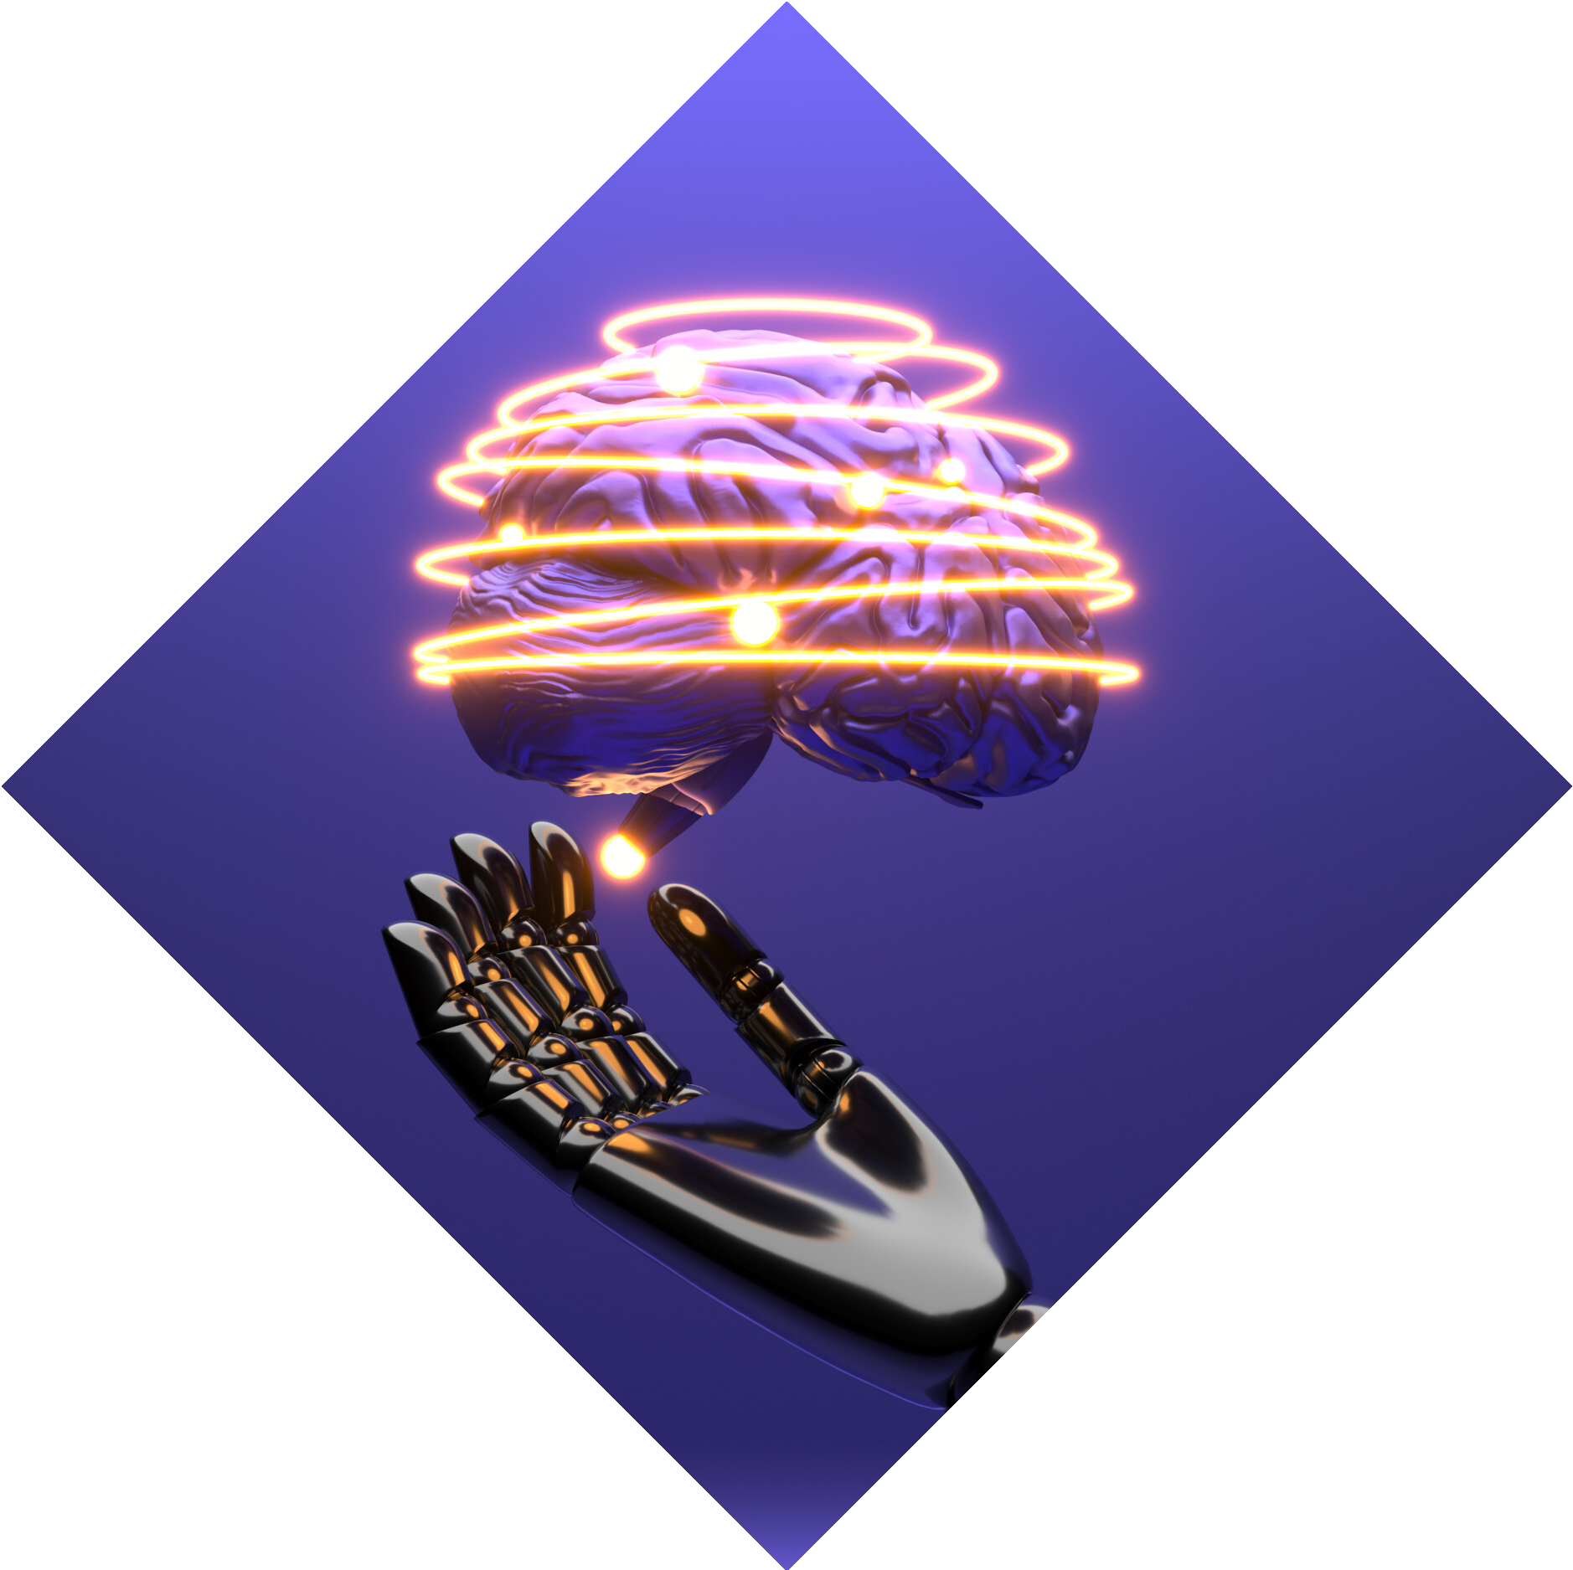
What is Resnet50?
Resnet 50 is a variant of the ResNet (Residual Network) architecture which is a type of convolutional neural network that was introduced in 2015. This architecture has 50 layers and it has been trained on large scale image recognition tasks.

Slide 5
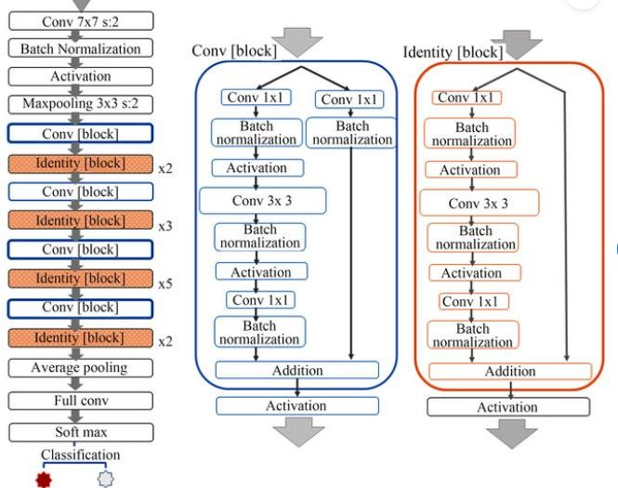
RESNET 50 ARCHITECTURE
Main components of the architecture include:
Input Layer: This layer takes in the input image and performs preprocessing
Convolution and Pooling layer: The first set of layers that performs initial feature extraction from the input image.
Residual Blocks: These contain multiple convolution layers and skip connections. These skip connections are to ensure gradient propagates through the network.
Fully connected layer: This is used to perform the final classification of the input image

Slide 6
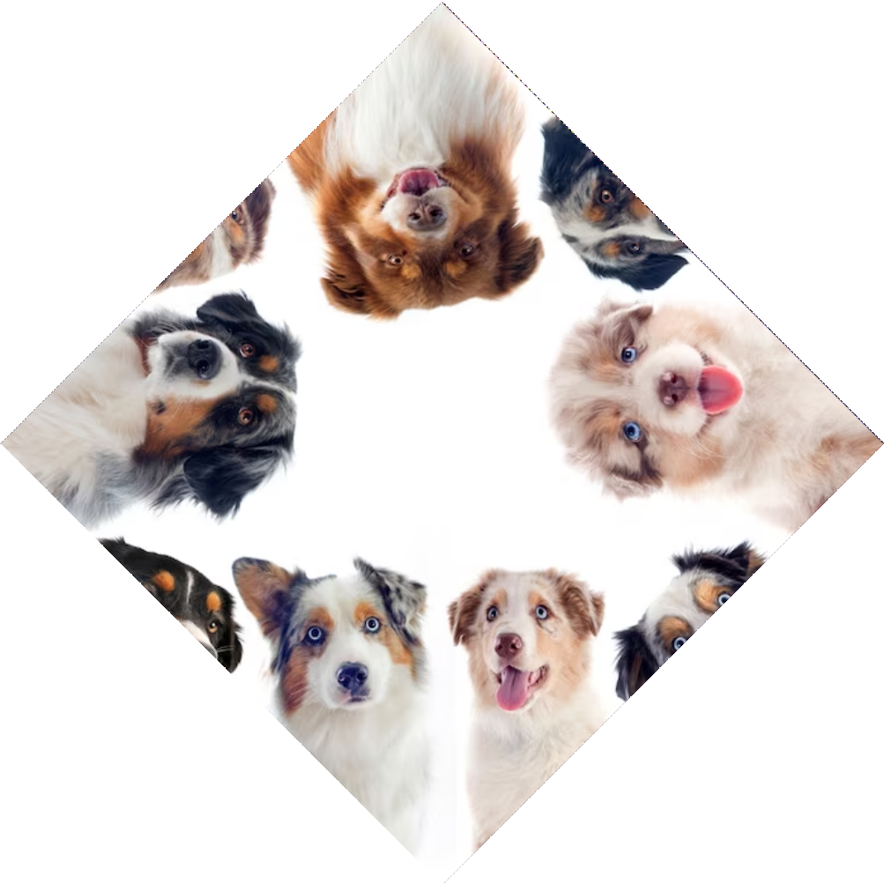
DOG BREED IDENTIFICATION
Dog breed identiﬁcation is a challenging task due to the large number of dog breeds and their visual similarities. Resnet50 can accurately identify dog breeds with an accuracy of over 90%. This technology can be used in various applications such as dog breeding, pet stores, and veterinary services.

Slide 7
ALGORITHM
Gather a dataset of dog images with their corresponding breed labels.
Preprocess the images by resizing them to a fixed size and normalizing the pixel values.
Load the ResNet50 model, pre-trained on ImageNet, without the top layer.
Add a new top layer with the number of nodes equal to the number of dog breeds in the dataset.
Train the model on the training set using a categorical cross- entropy loss function and an optimizer such as Adam.
Evaluate the model on the validation set and adjust the hyperparameters as needed to prevent overfitting.
Test the model on the test set.

Slide 8
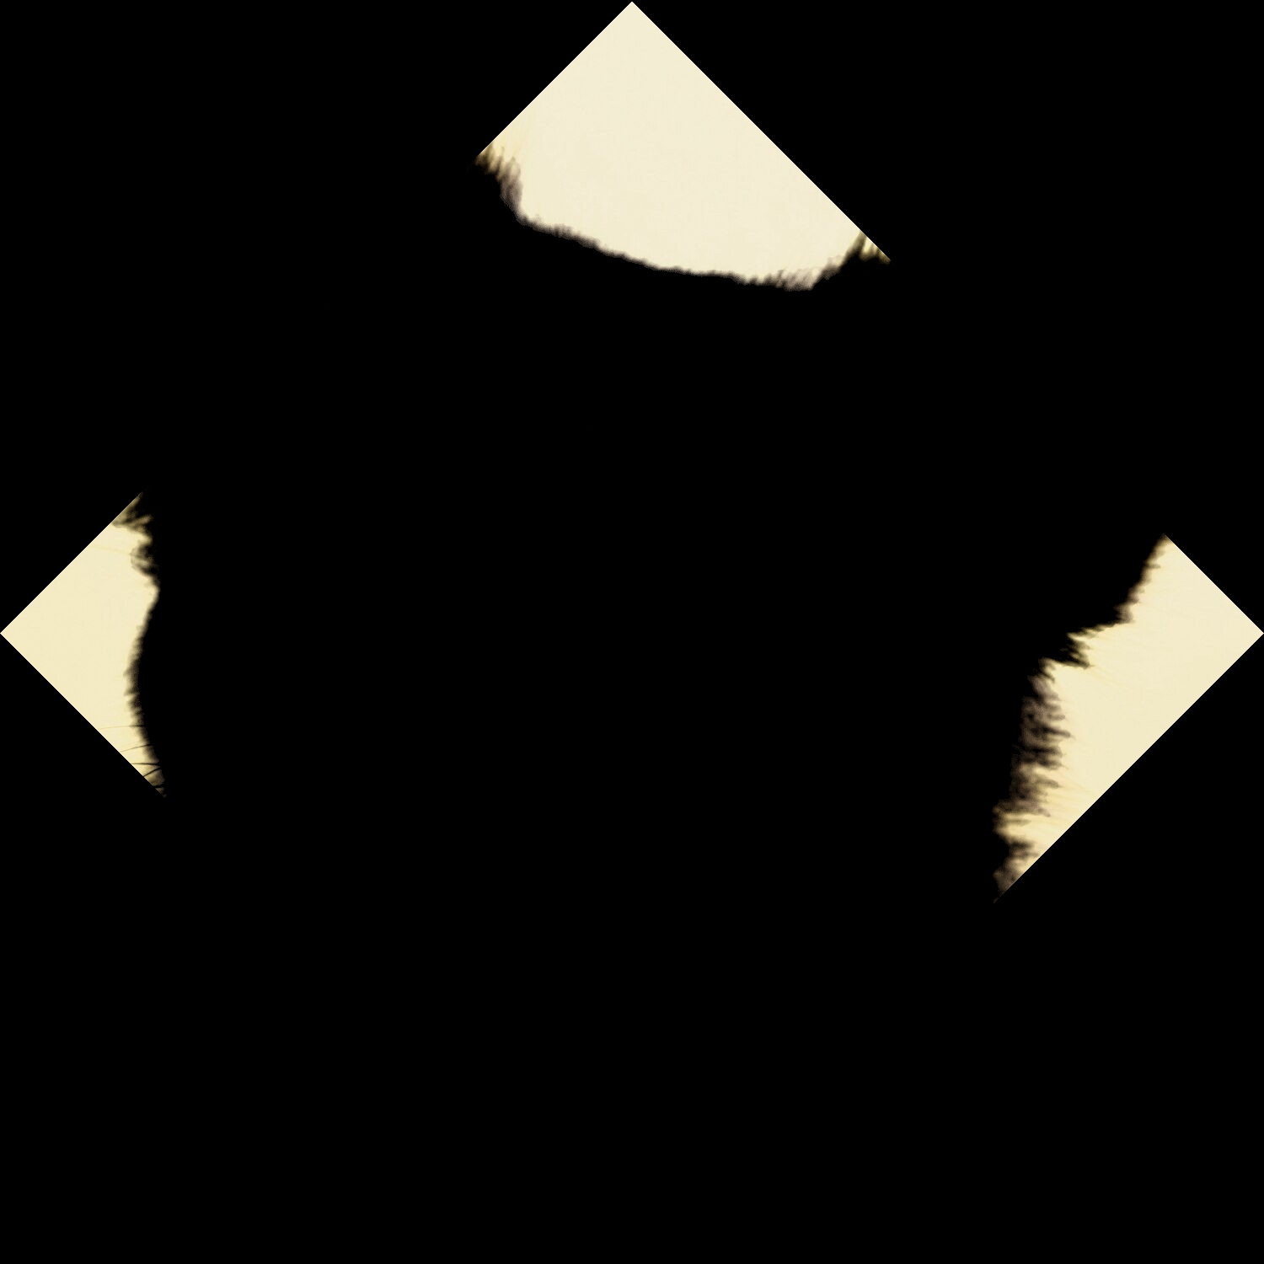
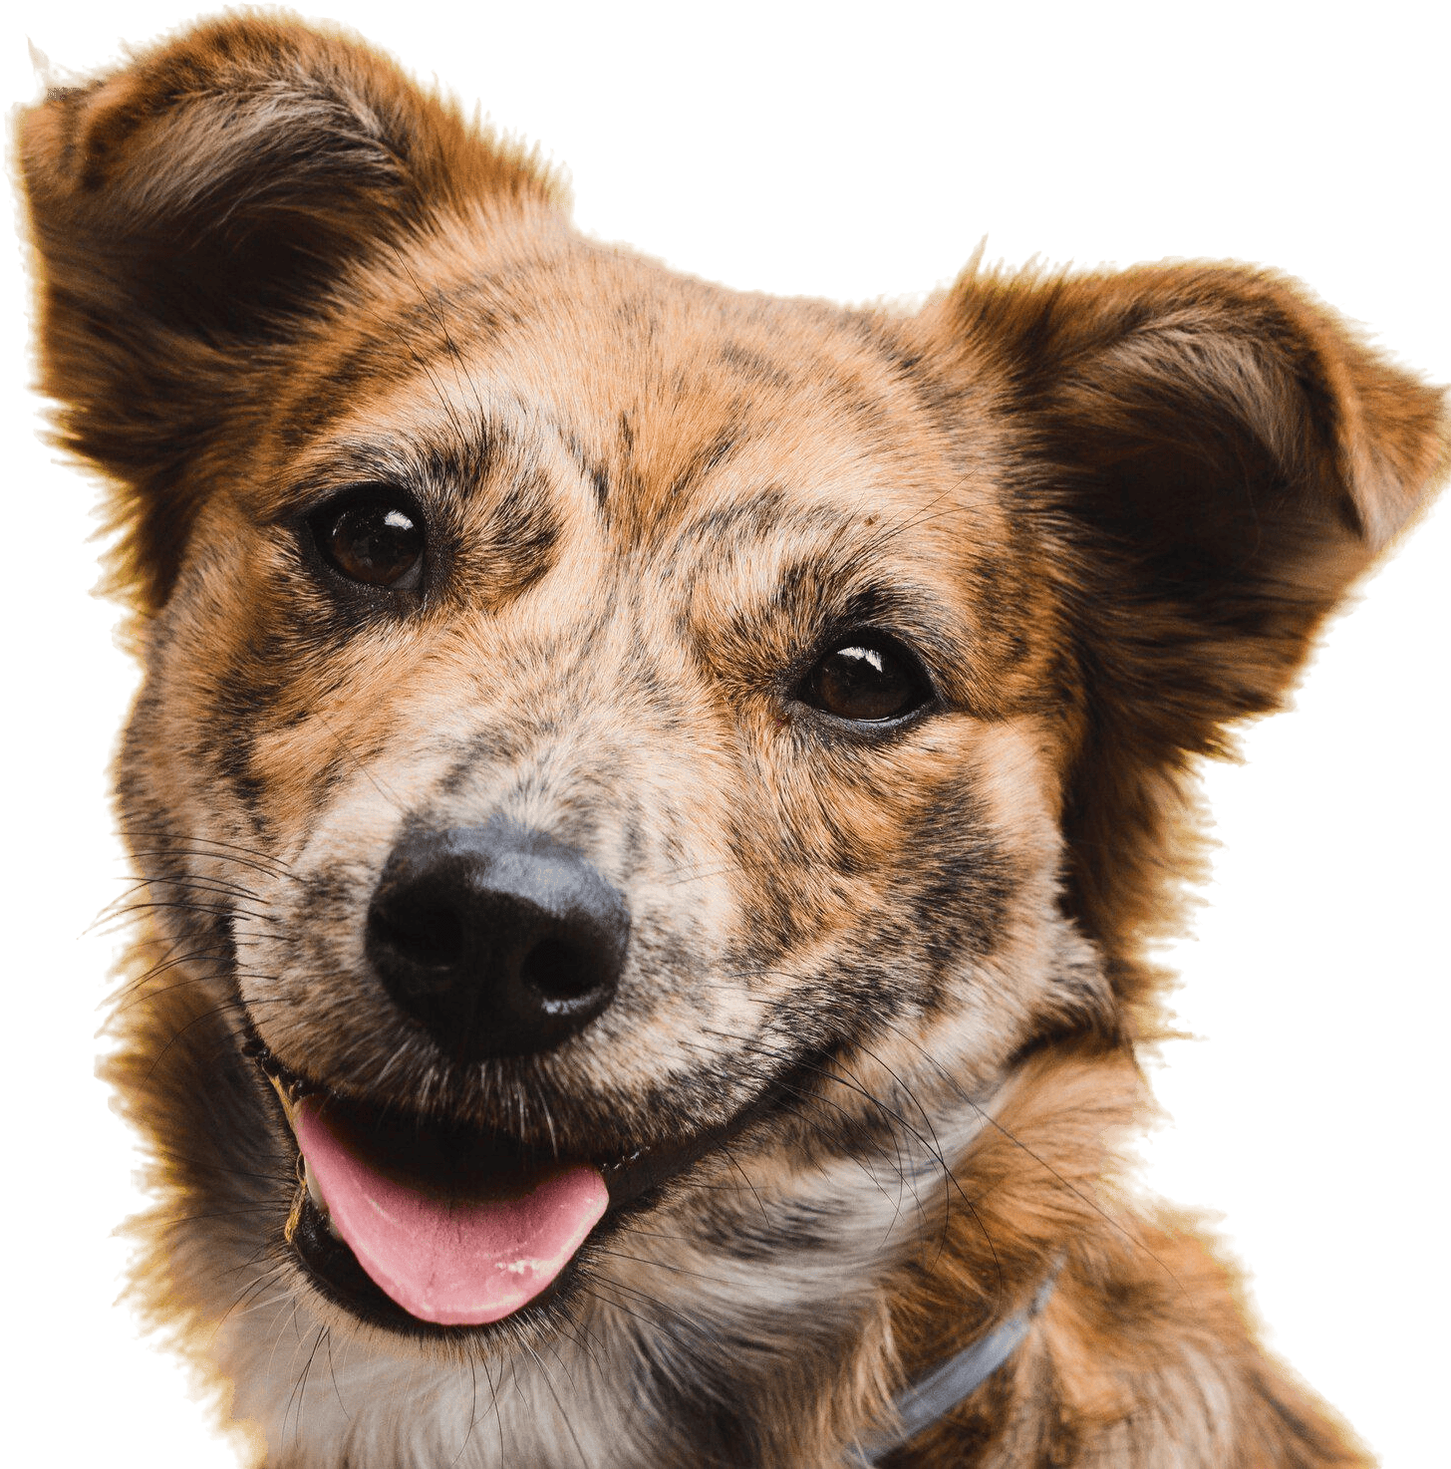
Data Preparation
To train Resnet50 for dog breed identiﬁcation, we need a large dataset of dog images with their corresponding breed labels. We have used the ImageNet dataset which is a large visual database designed for use in object recognition.
This database contains over 15 million images that have already been labelled.

Slide 9
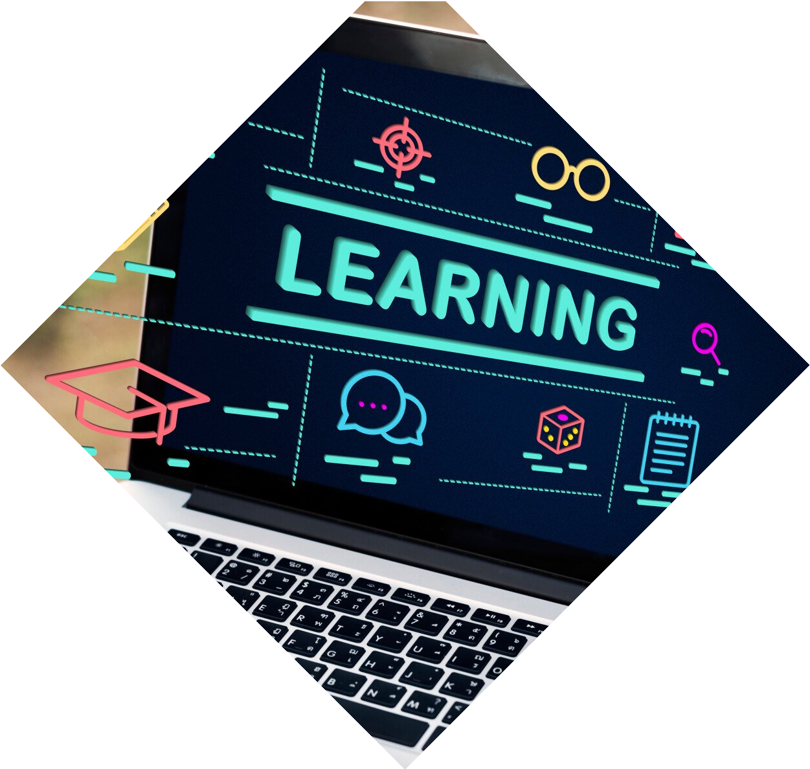
Training Resnet50
Training Resnet50 for dog breed identiﬁcation involves ﬁne-tuning the model on the dog image dataset. The model is initialized with pre-trained weights on the ImageNet dataset and then trained on the dog dataset. The training process involves adjusting the model's weights to minimize the classiﬁcation error.

Slide 10
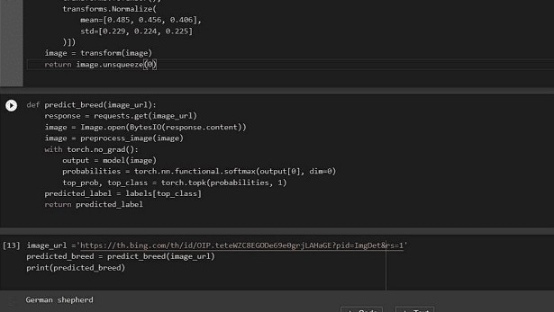
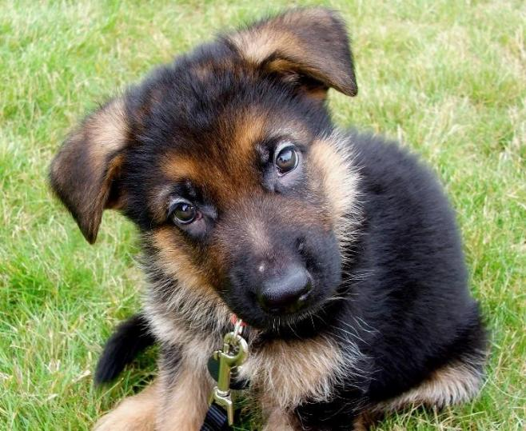
TESTING
To test the performance of the designed model an image of a German Shepherd is taken as an input image.
As we can see the output of the model also predicts that the image belongs to a German Shepherd breed.

Slide 11
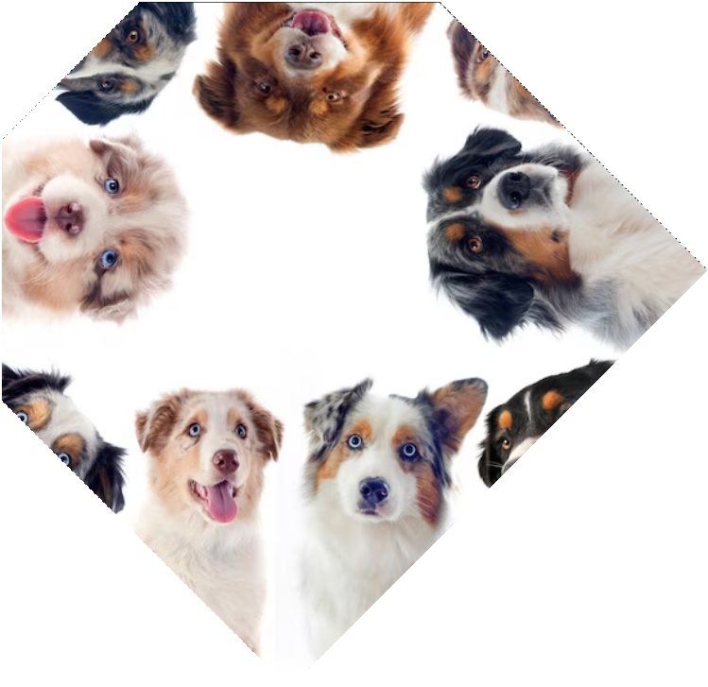
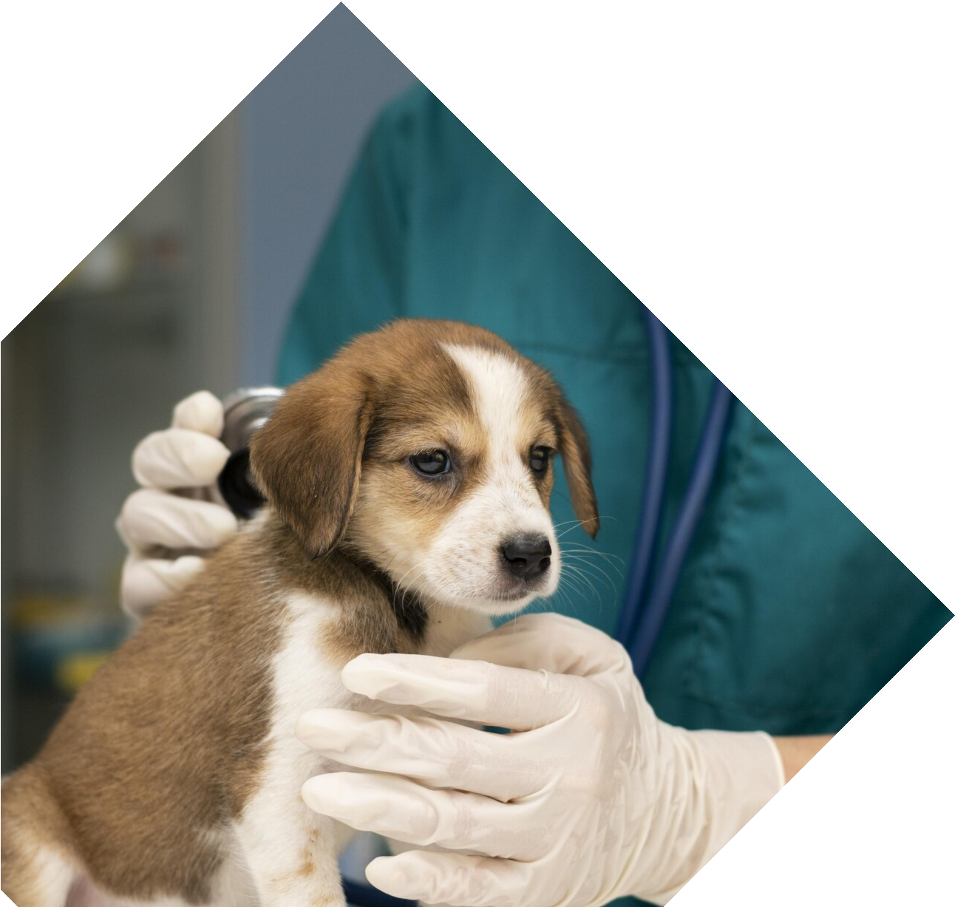
Applications
The accurate dog breed identiﬁcation provided by Resnet50 has many applications. It can be used in dog breeding to select the best breeding pairs, in pet stores to identify dog breeds for customers, and in veterinary services to diagnose dog health issues based on breed- speciﬁc characteristics.

Slide 12
CONCLUSION
The result demonstrates the potential of deep learning techniques in the field of computer vision and the models high accuracy suggests its potential use in various applications such as animal clinics and veterinary clinics.

Slide 13
Thank You!
TEAM MEMBERS
D VENU
J YASHWANTH CHANDRA
RITVIK AGGARWAL

